Slide 1

State of the
Non-Tenure-Track Faculty at Colorado State University
Committee on Non-Tenure-Track Faculty.
A Specialized Standing Committee of Faculty Council
Jennifer Aberle, Chair
Notes:
Faculty have been teaching, researching, engaging in service and outreach off of the tenure track for more than 50 years at Colorado State University (CSU). It is in the past decade that we have seen the number of these faculty grow to now make up more than 40% of the total faculty at CSU. There are a number of reasons for this growth, including funding allocations as well as supply and demand of higher education jobs. The information presented in these slides serve to set in context the changing of faculty at CSU and highlight challenges to these changes. Also presented here are some of the efforts being done to meet the challenges and set up partnerships for a new model of hiring, supporting, and thinking about faculty off of the tenure track. While none of the suggestions offered here are viable long-term solutions to the larger issues that face the endurance of tenure, the protection of academic freedom for all faculty, and unpredictable allocations of funding in higher ed, at CSU there are thoughtful intentions and efforts in play to ensure a professional and sustainable career trajectory for all faculty.

Slide 2
4 areas of information presented on these slides
Provide a Context and history to the current state of affairs for Faculty off of the Tenure Track at CSU.
Show Contributions, Advancements, and Challenges of non-tenure-track faculty at CSU.
Describe Collaborations that are working to uphold and highlight the work that Faculty do who are off of the Tenure Track. As well, explain recommendations for continued efforts to support and sustain faculty.
Engage administration, all faculty, research about academic labor for the purposes of innovation and creating strategies to actualize the recommendations toward a sustainable career path for all faculty and their engagement in the Missions of the University.
Notes:
Common goals of all faculty:
Student success
Sustainability of a free society, contributing to the betterment of society and the pursuit of knowledge, truth, and innovation
Professional development, meaning making, and personal pursuit for academic success / growth
Common Values of all faculty:
Accountability
Integrity
Respect
Achievement and advancement
Context – Who are the Non-Tenure-Track Faculty
numbers
roles & responsibilities
why this career path
Common goals, values, and challenges among faculty – education, research & service – innovation, student success, & advancement of a free society
Current Issues – what has been done
Future Issues – what needs to be addressed - Recommendations for Integrating, Collaboration, and Shared Governance among Faculty

Slide 3
De-Funding of Higher Education BEGINS
& thus ENSUES fewer tenure track lines and the hiring of a more flexible & more affordable Faculty
1st Report & Recommendations offered by Dean of CLA to improve working conditions for Faculty off of the Tenure Track
CSU Strategic Plan include goals for Faculty off of the Tenure Track, Including one of the First Major Salary Increases Ever
1974
Jan
1977
Jan
1980
Jan
1983
Jan
1986
Jan
1989
Jan
1992
Jan
1995
Jan
1998
Jan
2001
Jan
2004
2006
Jan
Today
Conversations Start in CO about "contingent faculty"
49% of the Undergrad Credit Hours Taught by NTT Faculty Teaching & Others off of the Tenure Track
Provost's Task Force for Special and Temporary Faculty is given charge by Provost Frank

Slide 4
1st Campus Equity Week Presentations held CSU
64% of the Undergrad Credit Hours Taught by NTT Faculty Teaching & Others off of the Tenure Track
Faculty Council approves the formation of the Advisory Committee on NTT Faculty
3/10
2006
Oct
Apr
2007
Oct
Apr
2008
Oct
Apr
2009
Oct
Apr
2010
2010
3/09
8/10
Today
Provost Approves the "6 R's" as Action Items to Improve the Working Conditions for NTT faculty
Task Force proposes Advisory Committee to Faculty Council on NTT Faculty
Advisory Committee on NTTF is Assembled (Committee on Non-Tenure-Track Faculty; CoNTTF)

Slide 5
President Frank Announces the Initiative to Improve the Working Conditions of NTT Faculty in the 2013 Fall Address
Colorado Legislature approves a law to offers options for Job Security & Academic Freedom: Multi-year Contracts for NTT Faculty
2010
Aug
Dec
Apr
2011
Aug
Dec
Apr
2012
Aug
Dec
Apr
2013
Aug
2013
2/11
Today
New NTT Faculty Appointment created: Senior Teaching Appointments
Faculty Council Adopts the use of Multi-Year Contracts for Special & Senior Teaching Faculty
CoNTTF proposes comprehensive recommendations to meet President Frank's Initiative

Slide 6
Faculty Council approves the conversion of the Advisory Committee to a Specialized Standing Committee
Faculty Council's Executive Committee invites CoNTTF for Discussion on NTT Faculty
President Frank Acknowledges improvements and tools for increased advancement
Provost Miranda Offers Guidelines for NTT Faculty Career Advancement
5/14
2014
Feb
Mar
Apr
May
Jun
Jul
Aug
Sep
Oct
Nov
Dec
2014
Today
60% of the Undergrad Credit Hours Taught by NTT Faculty Teaching & Others off of the Tenure Track
1st NTT Faculty Vote in Faculty Council - Chair of the Committee on Non-Tenure Track Faculty becomes a voting member of Faculty Council
Vice Provost Bush offers Training to Campus Leaders on NTT Faculty Career Trajectory
Less than 20% NTT Faculty are on Multi-year Contracts & Many Long-term NTT Faculty are not on Senior Teaching Appointments or do not have the security of bridge funding for their next research project.

Slide 7
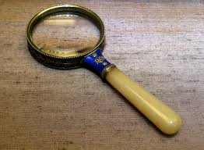
A Closer Look

Slide 8
CSU is one of the largest Comprehensive Public Research University, which has more than 31,500 students
6,701 employees of which 1,710 are faculty members and
Over 40% are on non-tenure track appointments
Colorado State University Fact Book 2013-2014

Slide 9
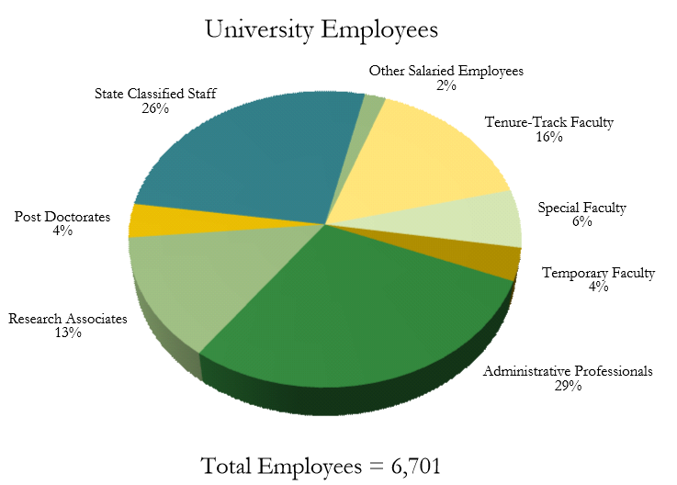
Colorado State University Fact Book 2013-2014
Notes:
CSU is approximately the 87th largest Comprehensive Public Research University, which has more than 31,000 students
6,701 employees of which 1,710 are faculty members and
40% are on non-tenure track appointments

Slide 10
Faculty, Graduate Students, & Administrative Professionals off of the Tenure Track
Teach more than
60% of the
Undergraduate Credit hours
Colorado State University Fact Book 2013-2014

Slide 11
More than 1,000
NTT Faculty, Research Associates & other Administrative Professionals provide
Vast and Valuable Contributions to Research & Scholarship on behalf of CSU
Without the Protections of Academic Freedom, ongoing Job Security, & for some Recognition for their Scholarship
Colorado State University Fact Book 2013-2014

Slide 12
40% of the faculty are off of the tenure track and Greater Than Half of these faculty have been working at CSU for More Than 10 YEARS
Yet, less than HALF of those Faculty have a commitment for more than a year at a time and even LESS currently have multi-year contracts.
Center for the Study of Academic Labor: 2014 – Non-Tenure-Track Faculty Survey

Slide 13
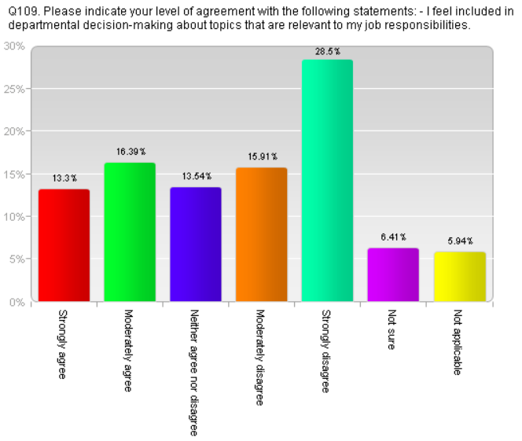
n = 432
Center for the Study of Academic Labor: 2014 – Non-Tenure-Track Faculty Survey

Slide 14
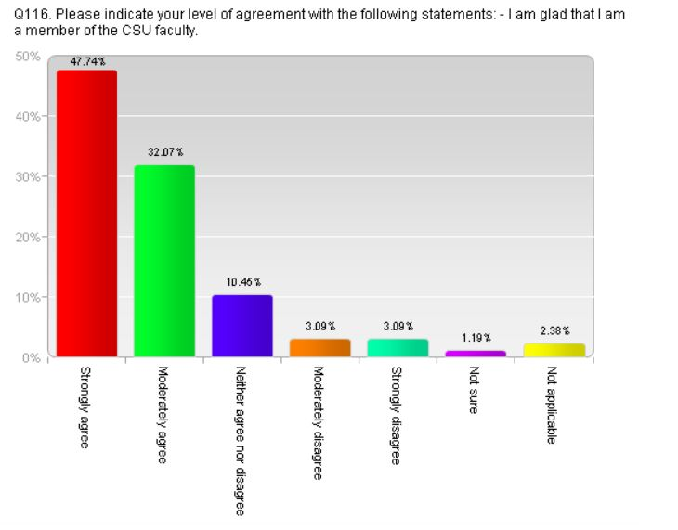
n = 432
Center for the Study of Academic Labor: 2014 – Non-Tenure-Track Faculty Survey

Slide 15
The Unusual Suspects

Slide 16
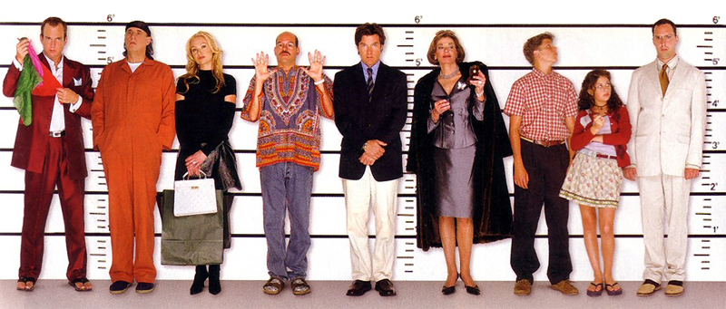
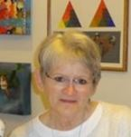

Do you recognize any of these people?

Slide 17
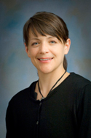
Jen Aberle, adjunct
Jen Aberle, PhD
Assistant Professor of Human Development and Family Studies
Director of the HDFS Online Degree Program
Co-Director of Undergraduate Programs in HDFS
CHHS Representative & Chair, Committee on Non-Tenure-Track Faculty
Teaching, Research, & Service on Senior Teaching Faculty Appointment for more than 14 years
Experience:
Senior Teaching Faculty, Teach courses in Death, Dying, & Grief, Parenting Across the Lifespan, and Development Across the Lifespan
Excellence in Education Award, Student-Athlete Advisor Committee and the Waterpik Corporation, Colorado State University
Researcher & Center Director, Center for the Study of Academic Labor, Colorado State University.
Managing Editor, Journal of Feminist Family Therapy. Department of Human Development and Family Studies, Colorado State University.
Aberle, J. T., Biringen, Z. Altenhofen, S., Bennet, S., Meyer, B., Moorlag, A., et al. (et al., (invited, December 2007). The use of the Attachment Q-Set and Emotional Availability (EA) in child care. In Biringen, Z. & Easterbrooks, A. N. et al. (Eds., invited special mini-series on child care, December 2007). Journal of Early Childhood and Infant Psychology.

Slide 18
Do you recognize any of these people?

Slide 19
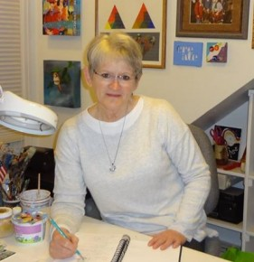
Natalie Selden Barnes, adjunct
Natalie Selden Barnes, MA
Instructor of Art and Art History
Key Academic Advisor
At-Large Representative, Committee on Non-Tenure-Track Faculty
Teaching, Research, & Service on Senior Teaching Faculty Appointment for more than 18 years
Advising: received Cermak Advising Award in 2012; have participated in CURC as a judge for two years; involved with First Generation activities for several years; Colorado Department of Higher Education, 60/60 Faculty to Faculty sessions (2011, 2012, 2013); Residence Life Advisory Board; Represent CSU Department of Art College Board AP Colloquium 2012; Department of Art & Art History Undergraduate and Curriculum committees
Teaching: Recipient of TILT Reinvention Center Science of Learning Course Development Competition, Spring 2014; Research Fellow, TILT 2012, “Writing Across the Curriculum” Research Proposal Award; TILT Master Teacher and Professional Development presentations; Currently responsible for ART100, 487, 384 and grade final portfolios for distance learning EDUC591, have also taught ART496I, 325, 326, EDUC466 and EDUC493
Research & Recent Artistry: CSU IRB approval “Writing Strategies for the Large Classroom” three year action research project; Artist-in-Residence, Homestead National Monument Park, Summer 2014; National Art Education Association Summer Visions 2014 participant; two-person show in Directions Gallery August 2014; Cover Illustration for “Rhetorical Readings for Advanced Writers,” Fountainhead Press

Slide 20
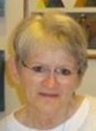
Do you recognize any of these people?

Slide 21
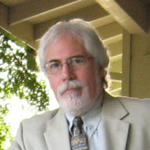
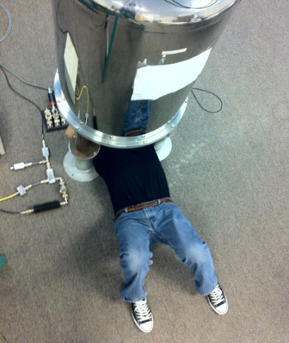
Joseph DiVerdi, adjunct
Joseph DiVerdi, PhD
Associate Professor of Chemistry
Experiential Physical Chemist
Scientific Instrument Development
CNS Representative, Committee on Non-Tenure-Track Faculty
Teaching, Research, & Service on Special Faculty Appointment for more than 5 years
Experience:
30 years of expertise in industry and higher education in the areas of nuclear Magnetic Resonance Spectroscopy & Imaging, Solid-State & in vivo NMR Spectroscopy, Scientific Instrumentation Design, Biophysical and Physical Chemistry, Science & Technology Education
Teach & Supervise Upper-Division Undergraduate Chemistry Laboratories
Hosted Several Students over the past 5 years for research experience in CSU Laboratories

Slide 22
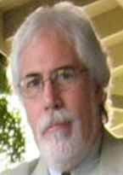
Do you recognize any of these people?

Slide 23
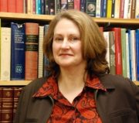
Laura Thomas, adjunct
Laura Thomas, MA
Instructor of English
Upper Division Composition Instructor
CLA Representative, Committee on Non-Tenure-Track Faculty
Teaching, Research, & Service on Senior Teaching Faculty Appointment for more than 15 years
Experience:
Senior Teaching Faculty, Teaches 7 upper-division composition courses per academic year
Service includes program evaluation, curriculum development and professional development of composition instructors
Representative CLA Adjunct Faculty Committee and on several English Dept. committees
Researcher & Contributor, Center for the Study of Academic Labor, Colorado State University

Slide 24
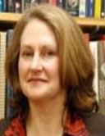
Do you recognize any of these people?

Slide 25

Collaborations & Recommendations
Notes:
Faculty types
Responsibilities
Roles
Career track
Stories of why we are here; choice
Common goals:
Student success
Sustainability of a free society, contributing to the betterment of society and the pursuit of knowledge, truth, and innovation
Professional development, meaning making, and personal pursuit for academic success / growth
Common Values:
Accountability
Integrity
Respect
Achievement and advancement
Context – Who are the Non-Tenure-Track Faculty
numbers
roles & responsibilities
why this career path
Common goals, values, and challenges among faculty – education, research & service – innovation, student success, & advancement of a free society
Current Issues – what has been done
Future Issues – what needs to be addressed - Recommendations for Integrating, Collaboration, and Shared Governance among Faculty

Slide 26
Committee on
Non-Tenure-Track Faculty
C.2.1.9.6 Specialized Standing Committees: Membership and Function (last revised August 8, 2014) - Committee on Non-Tenure-Track Faculty
The duties of this specialized standing committee shall be to recommend to the Faculty Council:
Policies defining the general responsibilities of non-tenure-track faculty to the University, college, and department.
2. Policies related to the standing of non-tenure-track faculty

Slide 27
Strengths
Supports & Resources
Concerns & Priorities

Slide 28
Colorado State University’s
Strategic Collaborations
Administrative Professional Council
Associated Students of Colorado State University
The Center for the Study of Academic Labor
Classified Personnel Council
Faculty Council
Faculty Council Standing Committees
The President’s Office
The Provost’s Office
The Ripple Effect
Standing Committee on the Status of Women Faculty
Student Success Initiatives
University Strategic Plan 2006 – 2015

Slide 29
Recommendations
& Initiatives
Rights, Representation, & Resources
  Orientation & Resources for NTT Faculty
  Define Workload Distributions & Relevant Evaluations
  Establish Procedures for assigning Appt. Types, Rank, & Promotion
  Participation in Governance & Relevant Decision-making at all Levels
  Offer Multi-Year Contracts to secure Academic Freedom
    Support for Offering Ideas, Opinions, & Innovations
    Support for Upholding Rigor and Accountability for the benefit of Students
  Provide Access to Due Process & Grievance
  Professional Development Opportunities & Instructional Support

Slide 30
Current Proposals
& Initiatives
Recognition, Respect, & Remuneration
  Develop a Culture that Values & Includes NTT Faculty at all Levels
  Offer Awards for Research and Teaching to NTT Faculty
  Secure Significant Salary Increases for Long-Term NTT Faculty
  Increase conversions to Senior Teaching Appointments
  Increase the use of Multi-Year Contracts for NTT Faculty
  Ensure the listing of NTT Faculty on College & Department websites
  Establish Research Bridge Funding for NTT Faculty
  Clarify & Disseminate Information about Benefits

Slide 31
  Continued efforts at CSU must revolve around:
      Innovate and Create a Vision
      Provide Strategies to advance all faculty
      Implement & Actualize CoNTTF’s Recommendations

Slide 32
Consider CSU’s Rationale for Tenure
Institutions of higher education are conducted for the common good and not to further the interest of either the individual or the institution as a whole. The common good depends upon the free search for truth and its free exposition. Tenure is a means to certain ends; specifically (1) freedom of teaching, research, extension, and of extramural activities, and (2) a sufficient degree of economic security to make the profession of university teaching attractive to men and women of ability. Academic freedom and economic security, and thus, tenure are indispensable to the success of an educational institution in fulfilling its singular obligations to its students and to society. Faculty members who are threatened with loss of their positions for voicing unpopular or innovative views cannot effectively engage in the kind of open deliberation and criticism essential to a free society.

Slide 33
Questions that will help us continue this effort of innovation:
How do we include NTT Faculty in areas of Faculty Governance, University Work, Student Success, and Awards & Recognition that are relevant and valuable to the work that these Faculty do at CSU?
How do we implement and enhance what is in the Academic Faculty and Administrative Professional Manual’s Codes and Policies to support NTT faculty:
  Senior Teaching Appointments – Section E.2.1.3
  Multi-Year Contracts – Section E.2.1.3 & E.2.1.4
  Definition of Academic Freedom – Section E.10.2

Slide 34
Questions that will help us continue this effort of innovation:
How do we provide for the future of the University, the Success of our students, by acknowledging the link between students’ learning environments and faculty’s work environments?
How do we ensure NTT Faculty’s
Rights, Representation, Recognition, Resources, Remuneration, and Respect (6 R’s (2006))
in long-term and meaningful ways that shape the culture for the good and endure the transitions in leadership and management of - Dept. Heads, Deans, or Upper Administration Officials?

Slide 35
Thank you ~
Committee on Non-Tenure-Track Faculty :
Representing | Member
Agricultural Sciences | Suellen Melzer-Drinnen
Business | Jenny Morse
Engineering | Steven Schaeffer
Health & Human Sciences | Jennifer Aberle
Liberal Arts | Natalie Barnes
Natural Resources | Natalie Ooi
Natural Sciences | Joseph DiVerdi
Vet Med & Biomedical Sciences | OPEN
Regular Faculty | Sue Doe
Regular Faculty | David Greene

